Slide 1


A Machine Learning approach for automatic disease detection in Chest X-Ray
Supervisor: Prof. Pier Luca Lanzi
Co-supervisor: Prof. Daniele Loiacono
Dr. Edoardo Giacomello
Candidate: Luca Nassano 893812
Academic Year: 2018/2019
MSc in Computer Science and Engineering

Slide 2

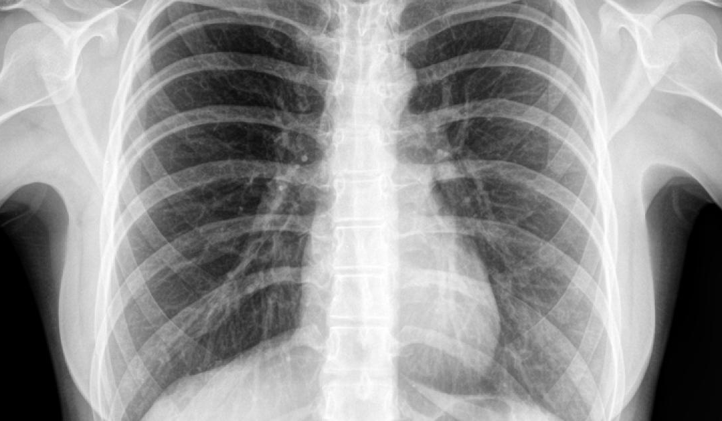


1. INTRODUCTION
What are Chest X-Rays?
Easy, fast and non–invasive medical test
Insert Your Image
What are Chest X-Rays?
A highly qualified figure is needed to read them
Hundreds of CXR generated by a single hospital everyday

Slide 3



1. INTRODUCTION
How AI can help radiology?
Speeding the Reading Process
Improve Diagnosis Accuracy
Improve Prioritization
An autonomous system takes second, instead of minutes, to read a Chest X-Ray
Automated Chest X-Ray may not replace human’s effort, but could offer a second opinion
A preliminary diagnosis may allow the physicians to focus first on the patients that need a prompt therapy

Slide 4
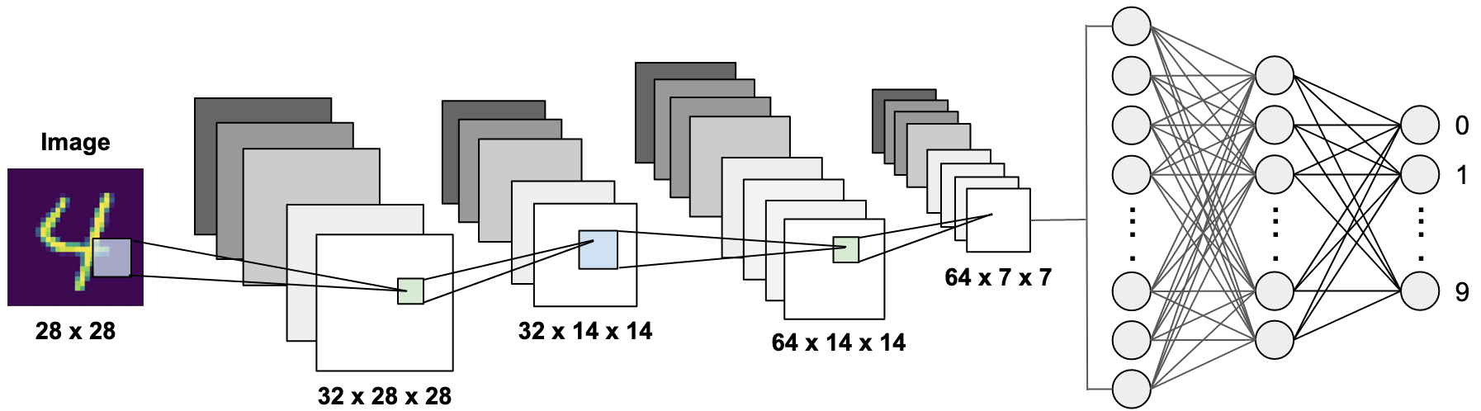
2. LITERATURE REVIEW
Yann LeCun introduce the first Convolutional Neural Network, used to classify handwritten digits
Zhou et al. propose a method to automatically extract a Class Activation Map using a CNN
2006
2019
1989
2016
Hinton et al. use CNNs to embed the input into a low dimensional space
Stanford University publish CheXpert dataset. Pham et al. achieve the best result on CheXpert competition

Slide 5
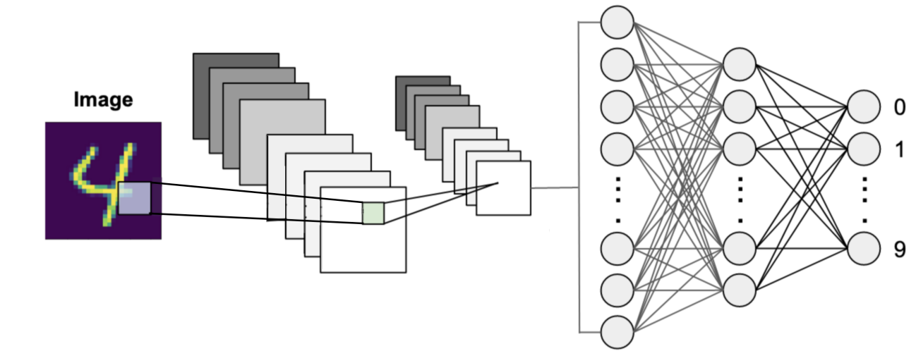
2. LITERATURE REVIEW
Yann LeCun introduce the first Convolutional Neural Network, used to classify handwritten digits
Zhou et al. propose a method to automatically extract a Class Activation Map using a CNN
Input Image
Embedding
2006
2019
1989
2016
Hinton et al. use CNNs to embed the input into a low dimensional space
Stanford University publish CheXpert dataset. Pham et al. achieve the best result on CheXpert competition

Slide 6
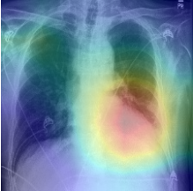
2. LITERATURE REVIEW
Yann LeCun introduce the first Convolutional Neural Network, used to classify handwritten digits
Zhou et al. propose a method to automatically extract a Class Activation Map using a CNN
2006
2019
1989
2016
Hinton et al. use CNNs to embed the input into a low dimensional space
Stanford University publish CheXpert dataset. Pham et al. achieve the best result on CheXpert competition

Slide 7
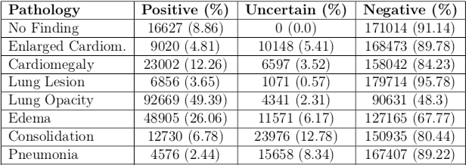
2. LITERATURE REVIEW
Yann LeCun introduce the first Convolutional Neural Network, used to classify handwritten digits
2006
2019
1989
2016
Hinton et al. use CNNs to embed the input into a low dimensional space
Stanford University publish CheXpert dataset. Pham et al. achieve the best result on CheXpert competition

Slide 8
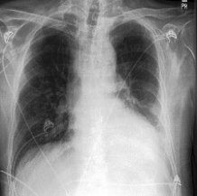


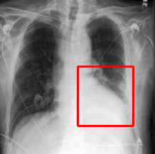
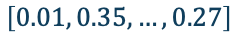
3. CHEST X-RAY AUTOMATED DIAGNOSIS
How the system works?
1
Classification: predict if a given pathology is present or not on a given CXR
Embedding Extraction: learn a compact numerical representation of the input
Cardiomegaly:
Edema:
Pleural Effusion:
2
$$\left[0.01, 0.35,…,0.27\right]$$
Class Activation Map: generating an image highlighting the region of the image influencing the classification
3
Bounding Box: use the generated CAM to automatically extract a bounding box
4

Slide 9




3. CHEST X-RAY AUTOMATED DIAGNOSIS
CheXpert: A Large Chest X-Ray Dataset
Structure
Labels
Training: 189116 CXR
Validation: 1911 CXR Test: 202 CXR
Each CXR is associated to 14 labels (each one representing a disease) with value among:
0: Absent
1: Present
U: Uncertain
Taxonomy
Pre-processing
Labels are organized according to a hierarchy: a child label is present only if its parent label is present too
Label Smooth Regularization
CXR rescaled to 224x224 px
Image normalization using ImageNet statistics

Slide 10
3. CHEST X-RAY AUTOMATED DIAGNOSIS
Convolutional Neural Network: baseline model
Convolutional Neural Networks
Different CNNs tested:
DenseNet121
DenseNet169
DenseNet169
VGG16
VGG19
InceptioResNetV2
Xception

Slide 11
3. CHEST X-RAY AUTOMATED DIAGNOSIS
Convolutional Neural Network: baseline model
Conditional Training
Exploit labels’ taxonomy with a two stage training
1st phase: training on parent level positive examples
2nd phase: fine tuning using the whole dataset
No Finding
Lung Opacity
Support Devices
Pneumothorax
Enlarged Cardiom.
Pleural Effusion
Edema
Consolidation
Lesion
Atelectasis
Cardiomegaly
Pneumonia

Slide 12
3. CHEST X-RAY AUTOMATED DIAGNOSIS
Ensemble Learning: combining multiple classifiers
Ensemble Learning:
Combining multiple classifier
Classifiers trained independently
Multiple combining policies
DenseNet121
Average
Input
DenseNet169
Predicted values
.
.
.
.
.
.
.
.
.
VGG19
1
Average
Classifiers predictions are combined using simple average
Gives the same importance to all the classifiers

Slide 13
3. CHEST X-RAY AUTOMATED DIAGNOSIS
Ensemble Learning: combining multiple classifiers
Ensemble Learning:
Combining multiple classifier
Classifiers trained independently
Multiple combining policies
DenseNet121
Entropy Weighted Average
Input
DenseNet169
Predicted values
.
.
.
.
.
.
.
.
.
VGG19
2
Entropy Weighted Average
Give less importance to the more uncertain classifiers
Entropy captures the level of uncertainty of a prediction
Predictions are averaged using entropies as weights

Slide 14

3. CHEST X-RAY AUTOMATED DIAGNOSIS
Ensemble Learning: combining multiple classifiers
Ensemble Learning:
Combining multiple classifier
Classifiers trained independently
Multiple combining policies
DenseNet121
Meta Learner
Input
DenseNet169
Predicted values
.
.
.
.
.
.
.
.
.
VGG19
3
Stacking
Train a new model, the Meta Learner, using output of base classifiers
The new model learns how to combine the predictions

Slide 15
3. CHEST X-RAY AUTOMATED DIAGNOSIS
CNN results
AUROC
Area Under Receiving Operating Characteristic
Captures model’s ability to discriminate whether a given condition is present or not
TPR
FPR
 | Atelectasis | Cardiomegaly | Consolidation | Edema | P. Effusion | Mean Performance
Single CNN | 0.854 | 0.800 | 0.891 | 0.920 | 0.917 | 0.876
AVG Ensemble | 0.854 | 0.811 | 0.908 | 0.936 | 0.933 | 0.888
Entropy Weighted AVG | 0.856 | 0.811 | 0.912 | 0.936 | 0.930 | 0.889
Stacking | 0.842 | 0.797 | 0.871 | 0.921 | 0.937 | 0.873

Slide 16
3. CHEST X-RAY AUTOMATED DIAGNOSIS
Is it possible to build a model using the Embeddings as input?
DenseNet121 Input Size Reduction
97,9%
Input Image
Embedding
Starting size: 224x224 = 50.176
Final size: 1.024
Random Forest
XGBoost
One model trained for each CNN

Slide 17
3. CHEST X-RAY AUTOMATED DIAGNOSIS
Embedding Results
 | Atelectasis | Cardiomegaly | Consolidation | Edema | P. Effusion | Mean Performance
CNNs Ensemble | 0.856 | 0.811 | 0.912 | 0.936 | 0.930 | 0.889
RF AVG Ensemble | 0.859 | 0.828 | 0.918 | 0.921 | 0.940 | 0.893
RF Entropy Weighted AVG | 0.872 | 0.826 | 0.918 | 0.916 | 0.936 | 0.897
XGB Average | 0.829 | 0.863 | 0.902 | 0.933 | 0.939 | 0.893
XGB Entropy Weighted AVG | 0.839 | 0.864 | 0.899 | 0.936 | 0.940 | 0.896

Slide 18
3. CHEST X-RAY AUTOMATED DIAGNOSIS
Final Model Results
 | Atelectasis | Cardiomegaly | Consolidation | Edema | P. Effusion | Mean Performance
CheXpert | 0.821 | 0.854 | 0.937 | 0.928 | 0.936 | 0.895
Our Approach | 0.860 | 0.860 | 0.917 | 0.934 | 0.939 | 0.902
Atelectasis
Cardiomegaly
Consolidation
Edema
Pleural Effusion
57
10
29
31
30
0
34
3
47
13
1
1
1
1
1
True Label
23
87
4
127
36
108
22
124
10
123
0
0
0
0
0
1
0
1
0
1
0
1
0
1
0
Predicted Label

Slide 19
3. CHEST X-RAY AUTOMATED DIAGNOSIS
Class Activation Map and Bounding Box generation
CXR given as input to the CNNs
Final CAM is obtained averaging the CAMs produced by the Neural Networks
A Mask is extracted from the CAM. The mask is used to extract the region affected by the pathology
The corners of that region are used to draw the bounding box

Slide 20
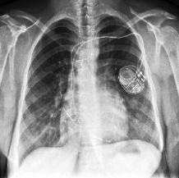
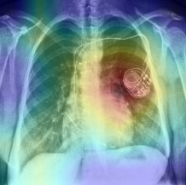
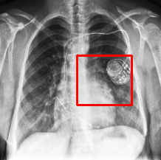
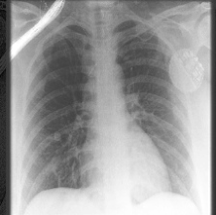
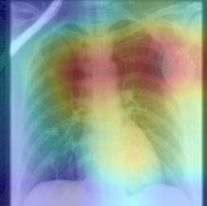
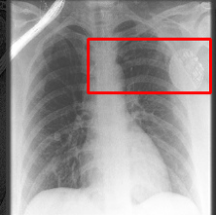
3. CHEST X-RAY AUTOMATED DIAGNOSIS
Class Activation Map & Bounding Box
Support Device

Slide 21

4. CONCLUSIONS AND FUTURE DIRECTIONS
Main Results
Future Directions
Use Lateral View Chest X-Rays and Test Time Augmentation
Very encouraging results
Novel approach to better combine different classifiers
Investigate different
Machine Learning
algorithms
Embedding-based models able to outperform Convolutional Neural Networks
Exploit Class Activation Map to improve diagnosis

Slide 22

THANK YOU!

Slide 23
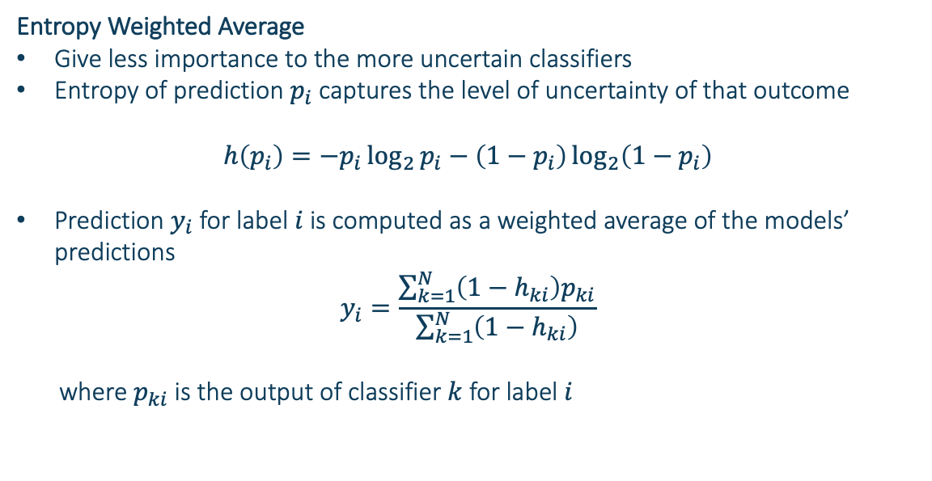
3. CHEST X-RAY AUTOMATED DIAGNOSIS
Ensemble: combine multiple classifiers
Entropy Weighted Average
Give less importance to the more uncertain classifiers
Entropy of prediction $p_{i}$ captures the level of uncertainty of that outcome
$$h\left(p_{i}\right)=−p_{i}\log_{2}{p_{i}−\left(1−p_{i}\right)\log_{2}\left(1−p_{i}\right)}$$
Prediction $y_{i}$ for label $i$is computed as a weighted average of the models’ predictions
$$y_{i}=\frac{\sum_{k=1}^{N}{\left(1−h_{ki}\right)p_{ki}}}{\sum_{k=1}^{N}{\left(1−h_{ki}\right)}}$$
where $p_{ki}$ is the output of classifier $k$ for label $i$

